Slide 1
OPERATION & METRIC ANALYTICS
Project no. 3 – using ADVANCE SQL

Slide 2
Agenda
Let’s dive into the project agenda which will be as follows:
In the project, by taking the role of a Lead Data Analyst at a company , we have to derive insights from the given data to answer questions posed by different departments within the company.
We have to provide valuable insights that can help improve company’s operations and understand sudden changes in key metrics using Advance SQL skills.

Slide 3
Steps
First let us begin the project by creating databases of case study 1 and case study 2 by using SQL commands and queries for the required insights.
After creating database we create table and insert the values and create a same tabular as present in excel sheet of case study 1.

Slide 4
Tasks to be carried out :-
A. JOB DATA ANALYTICS
Jobs reviewed over time.
Throughput analysis
Language share analysis
Duplicate rows detection
B. INVESTIGATING METRIC SPIKES
Weekly user management
User growth analysis
Weekly retention analysis
Weekly engagement per device
Email management analysis

Slide 5
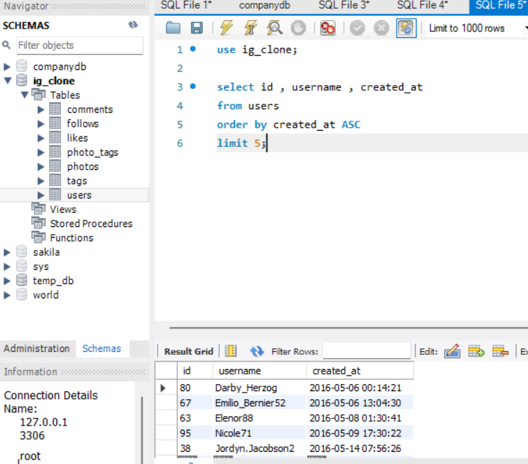
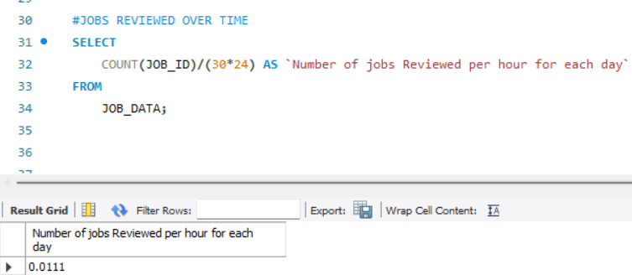
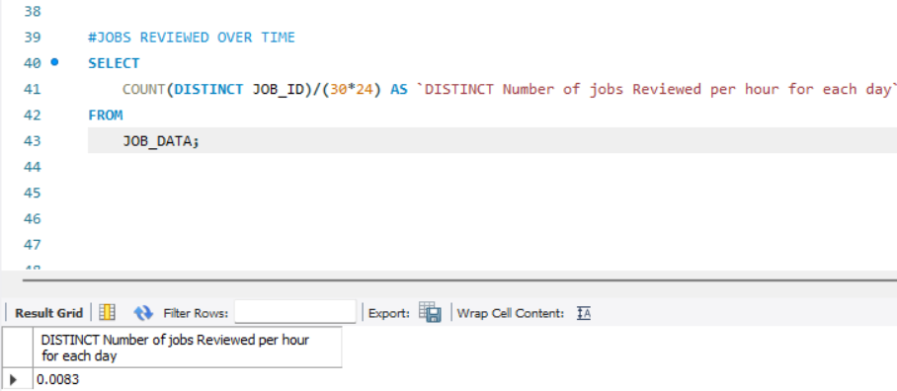
JOB DATA ANALYTICS
Jobs reviewed over time:
To calculate the number of jobs reviewed per hour for each day In November 2020.
We will use the JOB_ID column in this query and use the COUNT function & DISTINCT function to completely execute the query and get the required result.
Less then 0.1 jobs were reviewed.

Slide 6
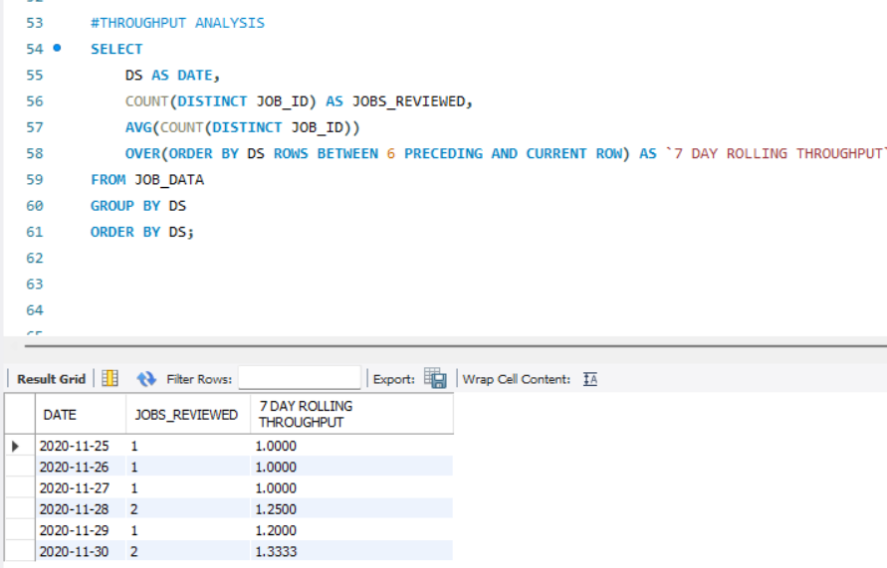
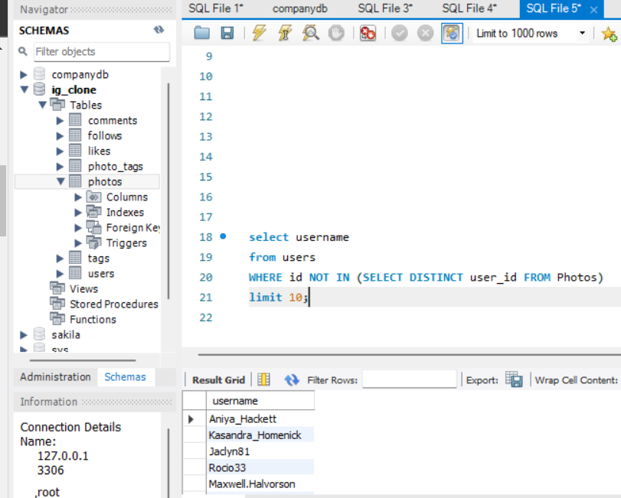
JOB DATA ANALYTICS
Throughput Analysis:
To calculate the 7-day rolling average of throughput analysis.
WHICH IS CONSIDERED THE BEST FOR THROUGHPUT.
Basically we have to calculate the number of events per second.
We will use the DS, JOB_ID, EVENTS column in this query and use the COUNT , ORDERY BY , GROUP BY , AVG function & DISTINCT function to completely execute the query and get the required result.

Slide 7
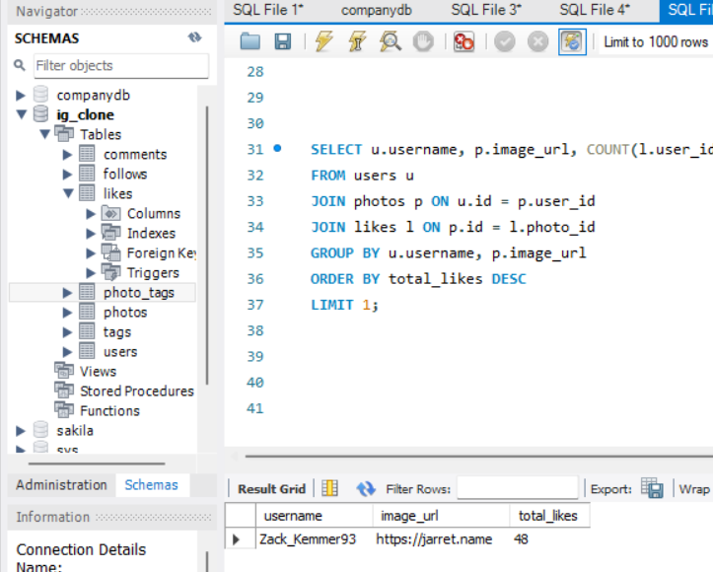
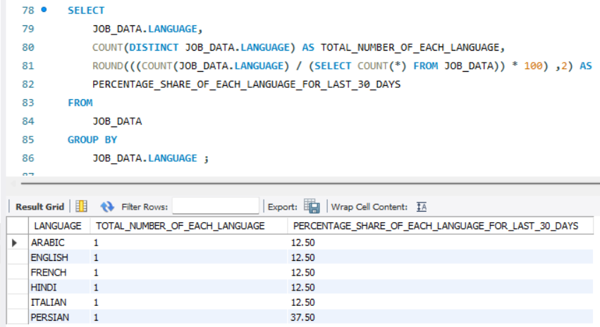
JOB DATA ANALYTICS
Language Share Analysis:
To calculate the percentage share of each language in the last 30 days.
We will use the LANGUAGE column in this query and use the COUNT , ROUND , GROUP BY , function & function to completely execute the query and get the required result.
The PERSIAN language has the highest share

Slide 8
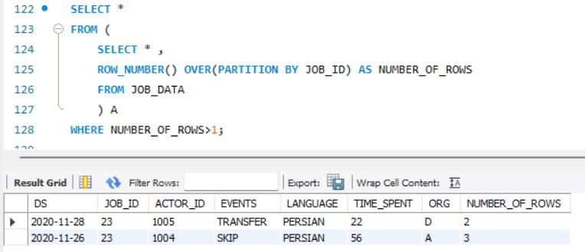
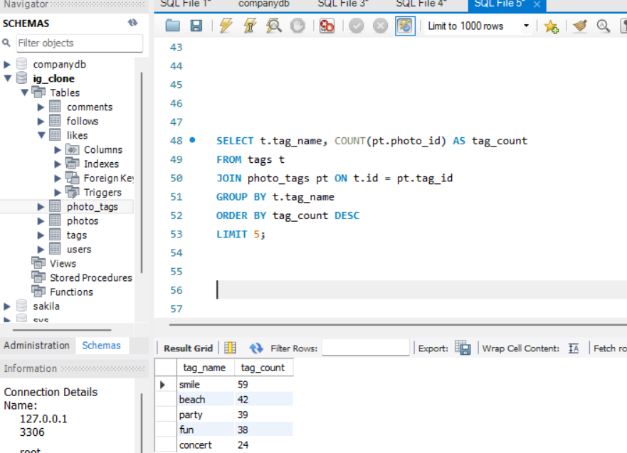
JOB DATA ANALYTICS
Duplicate Rows Detection:
To find out the duplicate rows in the whole data.
We will use the whole data and the ROW_FUNCTION function to completely execute the query and get the required result.

Slide 9
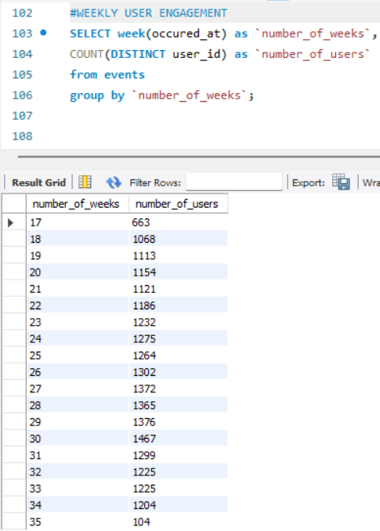
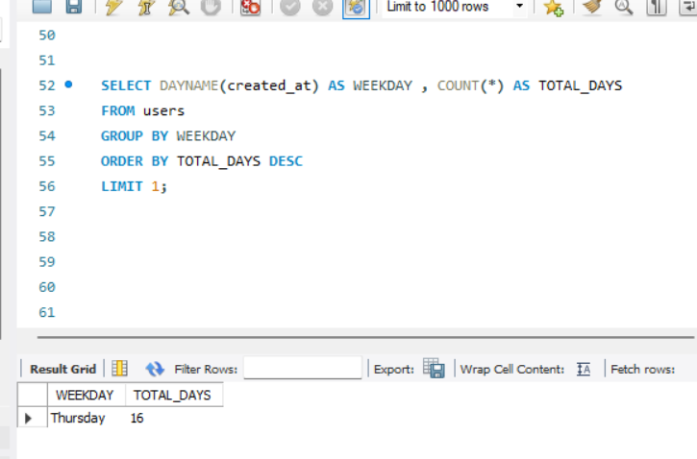
INVESTIGATING METRIC SPIKES
Weekly User Engagement:
To measure the activeness of users on a weekly basis.
We will use the EVENTS table and the SELECT , COUNT , ORDER BY , DISTINCT function to completely execute the query and get the required result.
Highest in 31st week

Slide 10
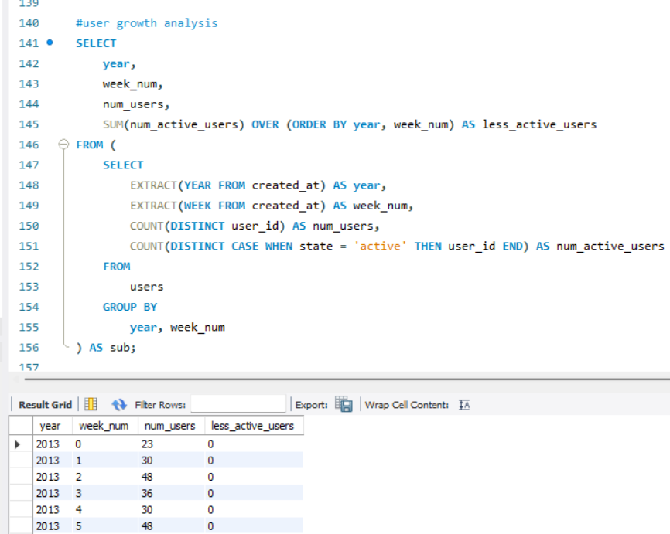
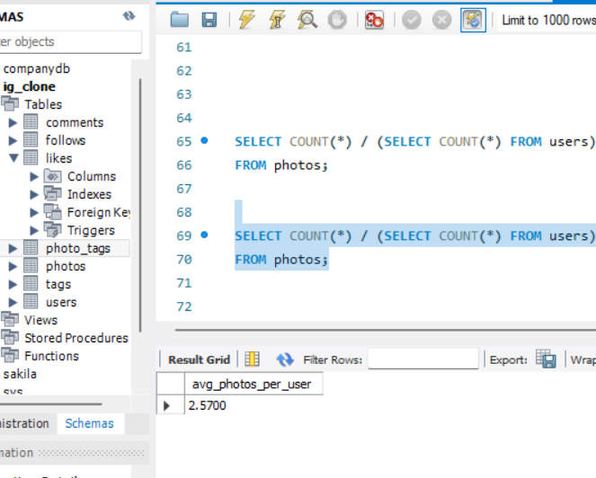
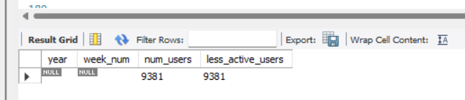
INVESTIGATING METRIC SPIKES
User Growth Analysis:
To calculate the user growth for the product
We will use the year , week , total users and a lot of functions to completely execute the query and get the required result.
Query was very tedious bt we got the output.

Slide 11
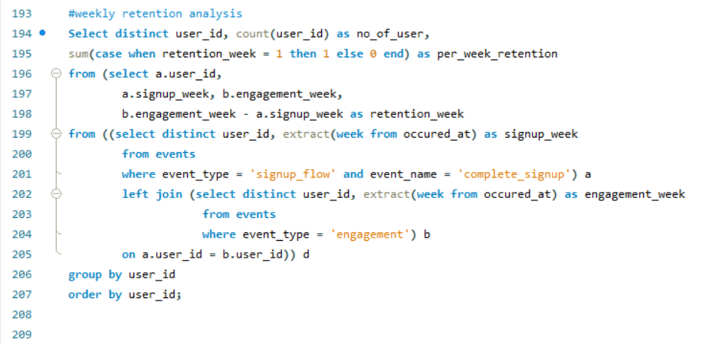
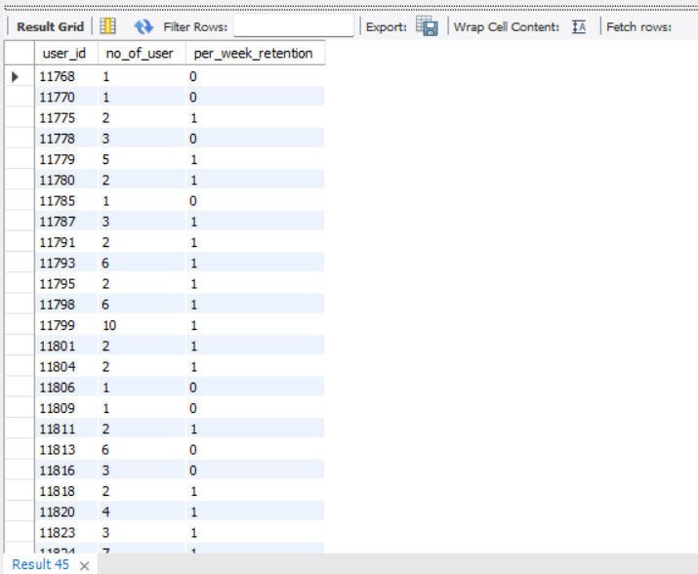
INVESTIGATING METRIC SPIKES
Weekly Retention Analysis:
To calculate the weekly retention of users based on their sign-up cohort.
One of the most challenging and the toughest query faced so far in the project.

Slide 12
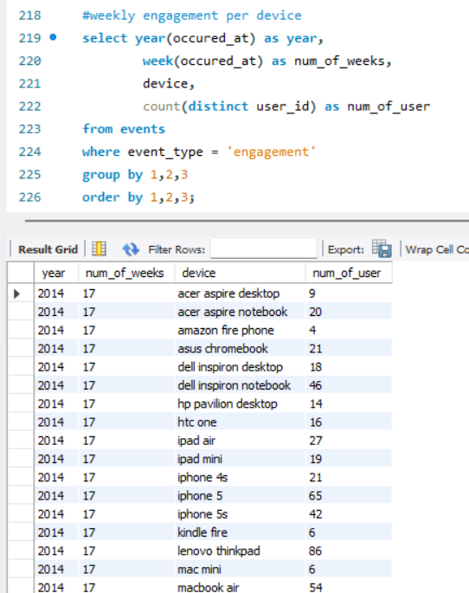
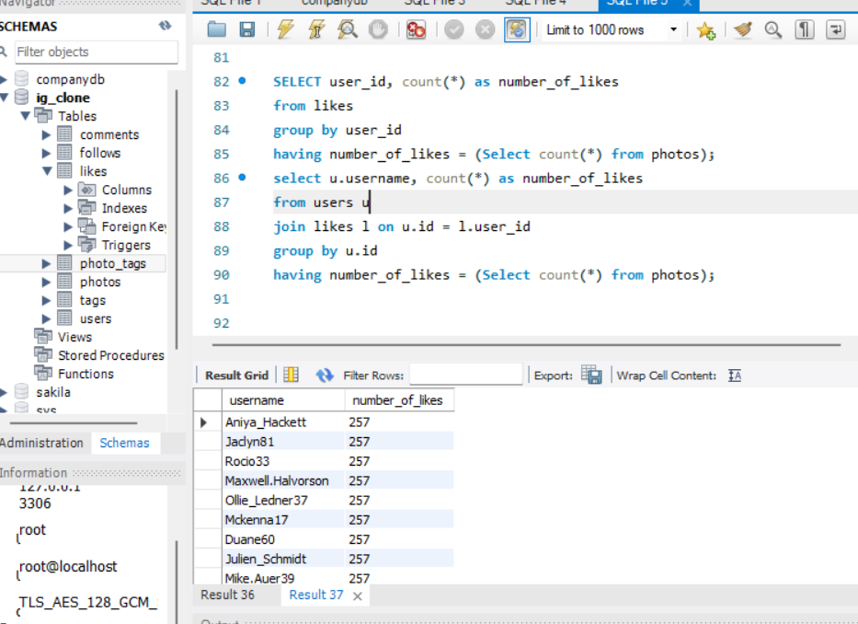
INVESTIGATING METRIC SPIKES
Weekly Engagement Per Device:
To calculate the weekly engagement per device
Highest engagement with product was a ‘MackBook Pro’

Slide 13

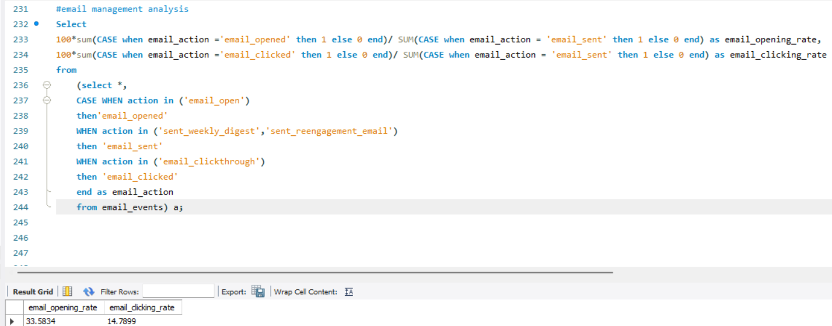
INVESTIGATING METRIC SPIKES
Email Management Analysis:
To calculate the engagement per device

Slide 14
Conclusion
Overall it was a very good project to gain complete and deep knowledge of SQL and ADVANCE SQL skills
Sql is easy once your understand how it works but to apply on the quries asked in project 3 was a quite challenging tasks as a data analyst.
Using sql and advance sql we got the required outputs.
All of the desired outputs were satisfactory and doing this project made me more interested in data analytics.

Slide 15
Thank you.
.

